Slide 1
日本的能源教育与能源发展
日本の科学教育とエネルギー発展
有马朗人

Slide 2
  １ 日本儿童的理科学力水平及成年人的科学技术理
解能力尚待提高
  ２ 一次能源及电力的需求总量在增加
  ３ 气候变化
  ４ 可再生能源
  ５ 福岛第一核电站事故
  ６ 东北电力女川核电站与东京电力福岛第二核电站
    6-1 东北电力女川核电站
    6-2 京电力福岛第二核电站
  7 人类原子能的将来

Slide 3
1 日本儿童的理科学力水平及成年人的科学技术理解能力尚待提高
日本の子供たちの理科の学力と成人の科学技術の理解不足

Slide 4
Achievement test scores of Japanese elementary and middle school students have been improved throughout the years in 2000’s compared with from 1960’s through 1990’s

Slide 6
2. TIMSS shows Math and Science knowledge of Japanese school students
[TIMSS: Trends in International Mathematics and Science Study]

Slide 7
TIMSS Grade 4 science
 | 1995 | score | 2003 | score | 2007 | score | 2011 | score
1 | Korea | 597 | Singapore | 565 | Singapore | 587 | Korea, Rep. of | 587
2 | Japan | 574 | Chinese Taipei | 551 | Chinese Taipei | 557 | Singapore | 583
3 | United States | 565 | Japan | 543 | Hong Kong SAR | 554 | Finland | 570
4 | Austria | 565 | Hong Kong | 542 | Japan | 548 | Japan | 559
5 | Australia | 562 | England | 540 | Russian | 546 | Russian | 552
6 | Netherlands | 557 | United States | 536 | Latvia | 542 | Chinese Taipei | 552
7 | Czech Republic | 557 | Latvia | 532 | England | 542 | United States | 544
8 | England | 551 | Hungary | 530 | United States | 539 | Czech Republic | 536
9 | Canada | 549 | Russian | 526 | Hungary | 536 | Hong Kong SAR | 535
10 | Singapore | 547 | Netherlands | 525 | Italy | 535 | Hungary | 534
11 | Slovenia | 546 | Australia | 521 | Kazakhstan | 533 | Sweden | 533
12 | Ireland | 539 | New Zealand | 520 | Germany | 528 | Slovak | 532
13 | Scotland | 536 | Belgium | 518 | Australia | 527 | Austria | 532
14 | Hong Kong | 533 | Italy | 516 | Slovak Republic | 526 | Netherlands | 531
15 | Hungary | 532 | Lithuania | 512 | Austria | 526 | England | 529
16 | New Zealand | 531 | Scotland | 502 | Sweden | 525 | Denmark | 528
17 | Norway | 530 | Moldova | 496 | Netherlands | 523 | Germany | 528
18 | Latvia (LSS) | 512 | Slovenia | 490 | Slovenia | 518 | Italy | 524
19 | Israel | 505 | Cyprus | 480 | Denmark | 517 | Portugal | 522
20 | Iceland | 505 | Norway | 466 | Czech Republic | 515 | Slovenia | 520
21 | Greece | 497 | Armenia | 437 | Lithuania | 514 | Northern Ireland | 517
22 | Portugal | 480 | Iran | 414 | New Zealand | 504 | Ireland | 516
作成：千々布（国立教育政策研究所）2013.10

Slide 8
TIMSS Grade 8 science
 | 1995 | score | 1999 | score | 2003 | score | 2007 | score | 2011 | score
1 | Singapore | 607 | Chinese Taipei | 569 | Singapore | 578 | Singapore | 567 | Singapore | 590
2 | Czech Republic | 574 | Singapore | 568 | Chinese Taipei | 571 | Chinese Taipei | 561 | Chinese Taipei | 564
3 | Japan | 571 | Hungary | 552 | Korea, Rep. of | 558 | Japan | 554 | Korea, Rep. of | 560
4 | Korea | 565 | Japan | 550 | Hong Kong | 556 | Korea, Rep. of | 553 | Japan | 558
5 | Bulgaria | 565 | Korea, Rep. of | 549 | Estonia | 552 | England | 542 | Finland | 552
6 | Netherlands | 560 | Netherlands | 545 | Japan | 552 | Hungary | 539 | Slovenia | 543
7 | Slovenia | 560 | Australia | 540 | Hungary | 543 | Czech Republic | 539 | Russian | 542
8 | Austria | 558 | Czech Republic | 539 | Netherlands | 536 | Slovenia | 538 | Hong Kong | 535
9 | Hungary | 554 | England | 538 | United States | 527 | Hong Kong | 530 | England | 533
10 | England | 552 | Finland | 535 | Australia | 527 | Russian | 530 | United States | 525
11 | Belgium | 550 | Slovak | 535 | Sweden | 524 | United States | 520 | Hungary | 522
12 | Australia | 545 | Belgium | 535 | Slovenia | 520 | Lithuania | 519 | Australia | 519
13 | Slovak | 544 | Slovenia | 533 | New Zealand | 520 | Australia | 515 | Israel | 516
14 | Russian | 538 | Canada | 533 | Lithuania | 519 | Sweden | 511 | Lithuania | 514
15 | Ireland | 538 | Hong Kong | 530 | Slovak | 517 | Scotland | 496 | New Zealand | 512
16 | Sweden | 535 | Russian | 529 | Belgium | 516 | Italy | 495 | Sweden | 509
17 | United States | 534 | Bulgaria | 518 | Russian | 514 | Armenia | 488 | Italy | 501
18 | Germany | 531 | United States | 515 | Latvia | 512 | Norway | 487 | Ukraine | 501
19 | Canada | 531 | New Zealand | 510 | Scotland | 512 | Ukraine | 485 | Norway | 494
20 | Norway | 527 | Latvia | 503 | Malaysia | 510 | Jordan | 482 | Kazakhstan | 490
21 | New Zealand | 525 | Italy | 493 | Norway | 494 | Malaysia | 471 | Turkey | 483
22 | Thailand | 525 | Malaysia | 492 | Italy | 491 | Thailand | 471 | Iran | 474
作成：千々布（国立教育政策研究所）2013.10

Slide 9
positive affect toward science inversely correlates with test score（TIMSS 2007）

Slide 10
PISA Scientific literacy
 | 2000 | score | 2003 | score | 2006 | score | 2009 | score | 2012 | score
1 | Korea | 552 | Finland | 548 | Finland | 563 | shanghai-China | 575 | Shanghai-China | 580
2 | Japan | 550 | Japan | 548 | Hong Kong-China | 542 | Finland | 554 | Hong Kong-China | 555
3 | Finland | 538 | Hong Kong-China | 539 | Canada | 534 | Hong Kong-China | 549 | Singapore | 551
4 | United Kingdom | 532 | Korea | 538 | Chinese Taipei | 532 | singapore | 542 | Japan | 547
5 | Canada | 529 | Liechtenstein | 525 | Estonia | 531 | Japan | 539 | Finland | 545
6 | New Zealand | 528 | Australia | 525 | Japan | 531 | Korea | 538 | Estonia | 541
7 | Australia | 528 | Macao-China | 525 | New Zealand | 530 | New Zealand | 532 | Korea | 538
8 | Austria | 519 | Netherlands | 524 | Australia | 527 | Canada | 529 | Viet Nam | 528
9 | Ireland | 513 | Czech Republic | 523 | Netherlands | 525 | Estonia | 528 | Poland | 526
10 | Sweden | 512 | New Zealand | 521 | Liechtenstein | 522 | Australia | 527 | Canada | 525
11 | Czech Republic | 511 | Canada | 519 | Korea | 522 | Netherlands | 522 | Liechtenstein | 525
12 | France | 500 | Switzerland | 513 | Slovenia | 519 | Chinese taipei | 520 | Germany | 524
13 | Norway | 500 | France | 511 | Germany | 516 | Germany | 520 | Chinese Taipei | 523
14 | United States | 499 | Belgium | 509 | United Kingdom | 515 | Liechtenstein | 520 | Netherlands | 522
15 | Hungary | 496 | Sweden | 506 | Czech | 513 | Switzerland | 517 | Ireland | 522
16 | Iceland | 496 | Ireland | 505 | Switzerland | 512 | United Kingdom | 514 | Australia | 521
17 | Belgium | 496 | Hungary | 503 | Macao-China | 511 | Slovenia | 512 | Macao-China | 521
18 | Switzerland | 496 | Germany | 502 | Austria | 511 | macao-China | 511 | New Zealand | 516
19 | Spain | 491 | Poland | 498 | Belgium | 510 | Poland | 508 | Switzerland | 515
20 | Germany | 487 | Slovak | 495 | Ireland | 508 | Ireland | 508 | Slovenia | 514
21 | Poland | 483 | Iceland | 495 | Hungary | 504 | Belgium | 507 | United Kingdom | 514
22 | Denmark | 481 | United States | 491 | Sweden | 503 | Hungary | 503 | Czech Republic | 508
23 | Italy | 478 | Austria | 491 | Poland | 498 | United States | 502 | Austria | 506
24 | Liechtenstein | 476 | Russian | 489 | Denmark | 496 | Czech | 500 | Belgium | 505
25 | Greece | 461 | Latvia | 489 | France | 495 | Norway | 500 | Latvia | 502
26 | Russian | 460 | Spain | 487 | Croatia | 493 | Denmark | 499 | France | 499
27 | Latvia | 460 | Italy | 486 | Iceland | 491 | France | 498 | Denmark | 498
28 | Portugal | 459 | Norway | 484 | Latvia | 490 | Iceland | 496 | United States | 497
29 | Luxembourg | 443 | Luxembourg | 483 | United States | 489 | Sweden | 495 | Spain | 496
30 | Mexico | 422 | Greece | 481 | Slovak | 488 | Austria | 494 | Lithuania | 496
31 | Brazil | 375 | Denmark | 475 | Spain | 488 | Latvia | 494 | Norway | 495

Slide 11
The number of participating countries and regions in PISA
2000 31
2003 40
2006 57
2009 65
2012 65

Slide 12
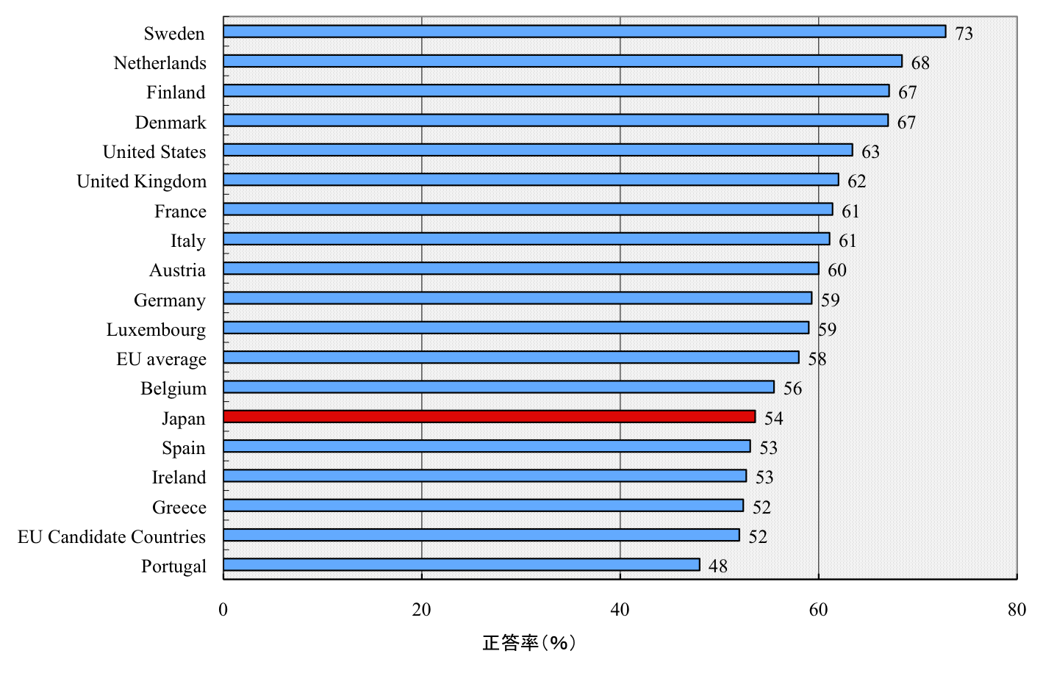
Understanding and Interest of Science and Technology in the World Today
（2001年）
% of correct answers
Notes:
12
12

Slide 13
Non-scientific rumors have been circulated.
Because of the rumors, people do not want to buy products of Fukushima prefecture and its neighbors.

Slide 14
The education of radioactivity and radiation must be given in junior high schools.
In Japan, this was stopped from 1981 through 2011.
This was a great mistake.
Citizens are afraid of radiation, because they do not know what is radiation.

Slide 15
 | Literacy proficiency | Mean | Numeracy proficiency | Mean | Proficiency in problem solving in technology-rich environments percentage of Level2,3 | Mean | Proficiency in problem solving in technology-rich environments | Mean
1 | Japan | 296 | Japan | 288 | Sweden | 44% | Japan | 294
2 | Finland | 288 | Finland | 282 | Finland | 42% | Austria | 289
3 | Netherlands | 284 | Flanders | 280 | Netherlands | 42% | Finland | 289
4 | Australia | 280 | Netherlands | 280 | Norway | 41% | Sweden | 288
5 | Sweden | 279 | Sweden | 279 | Denmark | 39% | Netherlands | 286
6 | Norway | 278 | Norway | 278 | Australia | 38% | Norway | 286
7 | Estonia | 276 | Denmark | 278 | Canada | 37% | Austria | 284
8 | Flanders | 275 | Czech Republic | 276 | Germany | 36% | Czech Republic | 283
9 | Czech Republic | 274 | Slovak Republic | 276 | Japan | 35% | Denmark | 283
10 | Slovak Republic | 274 | Austria | 275 | Flanders (Belgium) | 35% | Germany | 283
11 | Canada | 273 | Estonia | 273 | England | 35% | Korea | 283
12 | Korea | 273 | Germany | 272 | Czech Republic | 33% | Canada | 282
13 | England | 272 | Australia | 268 | Austria | 32% | Slovak Republic | 281
14 | Denmark | 271 | Canada | 265 | United States | 31% | Flanders (Belgium) | 281
15 | Germany | 270 | Cyprus | 265 | Korea | 30% | England | 280
16 | United States | 270 | Korea | 263 | Estonia | 28% | Estonia | 278
17 | Austria | 269 | England | 262 | Slovak Republic | 26% | Ireland | 277
18 | Cyprus | 269 | Poland | 260 | Ireland | 25% | United States | 277
19 | Poland | 267 | Ireland | 256 | Poland | 19% | Poland | 275
20 | Ireland | 267 | France | 254
21 | France | 262 | United States | 253
22 | Spain | 252 | Italy | 247
23 | Italy | 250 | Spain | 246
 | Average | 273 | Average | 269 | Average | 34% | Average | 283
ＰＩＡＡＣ（２０１３）

Slide 16
２ 一次能源及电力的需求总量在增加
一次エネルギー及び電力の需要の増加

Slide 17
Explosion of world population
2050: 9.2billion
2011: 7 billion
2008: 6.7billion
1987: 5.0billion
B.C.8000
0
500
1000
2000
Begin of agriculture
and cattle breeding
Plague
epidemic
Industrial
revolution
※2006年版世界人口推計（中位推計）より
Notes:
最初の発表ということで，イノベーションの定義を簡単にしておきます．
・・・二つの絵についてアドリブで説明・・・
17

Slide 18
Fig.1 Estimation of World Population(medium variant)
Source: Population Division of the Department of Economic and Social Affairs of the United Nations Secretariat World Population Prospects: The 2010 Revision, http://esa.un.org/unpd/wpp/index.htm

Slide 19
Regional Population and Energy Consumption per Person
world population（２００９年）
World Primary Energy Consumption（２００９年）
consumption（Tons of Oil Equivalent）
Energy Consumption per Person（2009年）
出典：IEA Energy Balances of OECD /NON-OECD Countries 2011

Slide 20
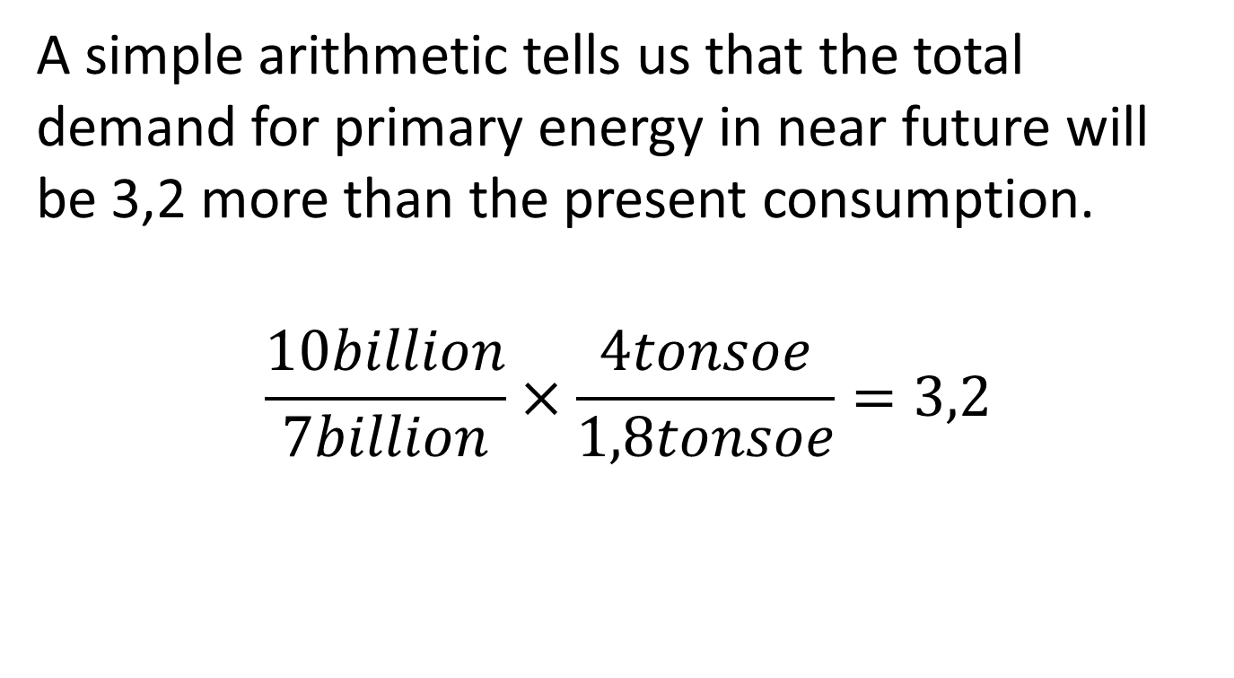
A simple arithmetic tells us that the total demand for primary energy in near future will be 3,2 more than the present consumption.
$$\frac{10billion}{7billion}×\frac{4tonsoe}{1,8tonsoe}=3,2$$

Slide 21
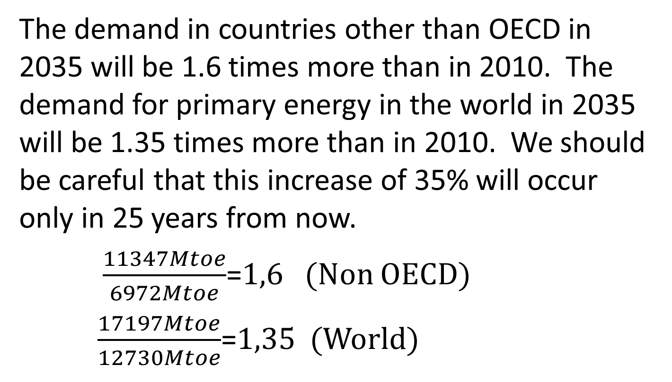
The demand in countries other than OECD in 2035 will be 1.6 times more than in 2010. The demand for primary energy in the world in 2035 will be 1.35 times more than in 2010. We should be careful that this increase of 35% will occur only in 25 years from now.
$\frac{11347Mtoe}{6972Mtoe}$=1,6 (Non OECD)
$\frac{17197Mtoe}{12730Mtoe}$=1,35 (World)

Slide 22
If this increase continues linearly for the next 100 years, we find a 140% increase, namely altogether 2.4 times more than the present consumption.

Slide 23
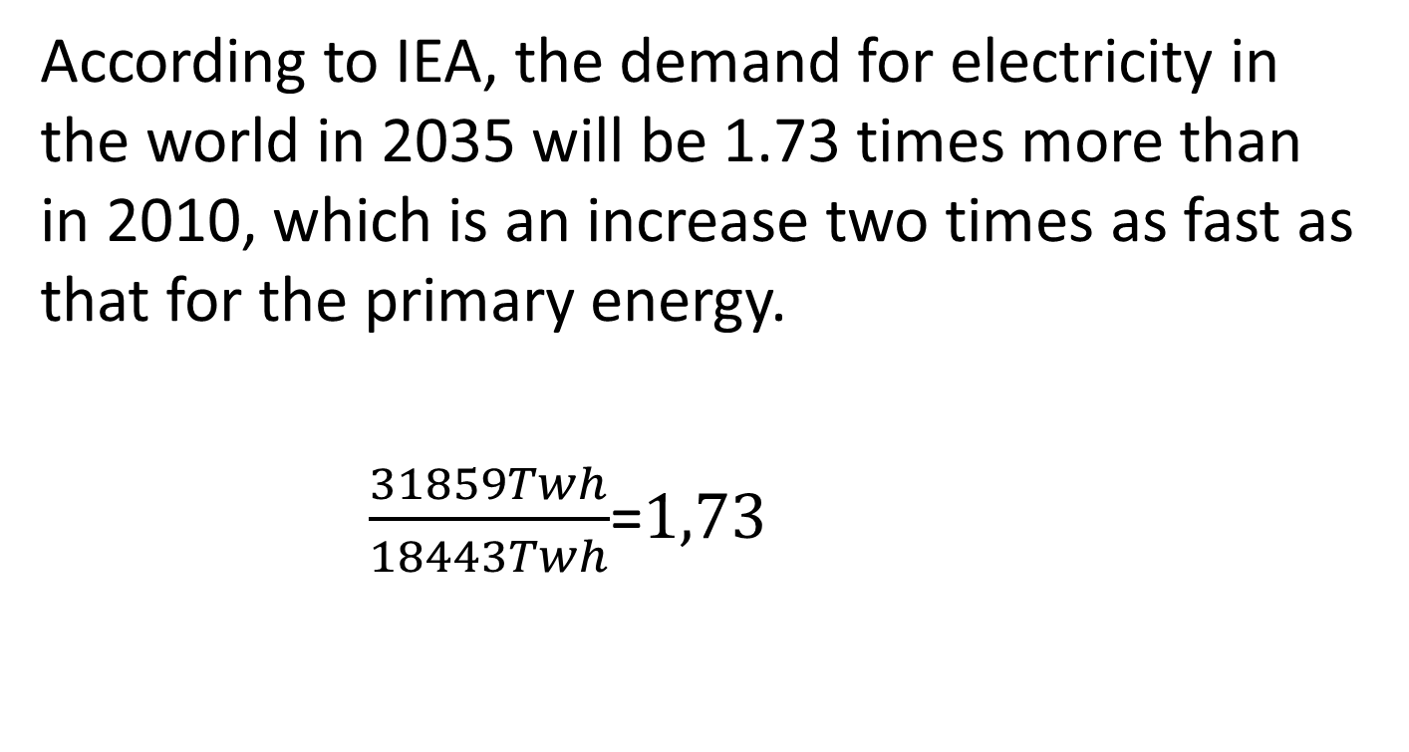
According to IEA, the demand for electricity in the world in 2035 will be 1.73 times more than in 2010, which is an increase two times as fast as that for the primary energy.
$\frac{31859Twh}{18443Twh}$=1,73

Slide 24
日本的能源自给率
○若不考虑核电，日本的能源自给率仅为4％。
○主要发达国家之中最低水平。远远低于粮食自给率(40％)。
［％］
＜主要发达国家能源自给率＞
［％］
＜主要发达国家的粮食自给率＞
主要发达国家之中最低水平。
大大低于 粮食自给率。
【出典】OECD/IEA,「Energy Balances of OECD Countries, 2011 Edition」
【出典】農林水産省ホームページより作成
日本は2009年、他は2007年のデータ
Notes:
次にわが国の現状についてご説明します。
日本はエネルギー資源がほとんど国内にありません。石油、ウランなどは１００％輸入に頼っており、天然ガスもほんのわずかしか産出していません。
したがって、エネルギーの自給率は、わずか４％と先進国中でも最低の水準であり、そのほとんどは水力という状況です。
おまけに島国のため、欧州のように各国間でガスのパイプラインがつながっていたり、電力の送電網が張り巡らされているわけでもありません。したがって、エネルギーの供給構造はきわめて脆弱であるといわざるをえません。
エネルギーの確保は、経済活動や国民生活の基本であり、食糧問題などと同様に、国家としての最重要の課題の一つといえます。諸外国と比べて低いといわれている食料自給率でさえ40%であり、エネルギーはそれよりもさらに一桁小さい数値というわけです。

Slide 25
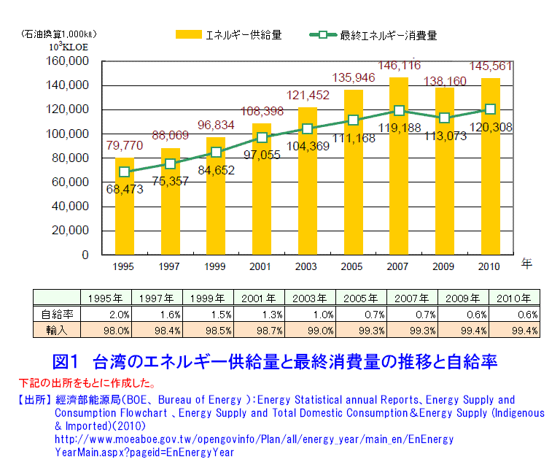
能源供给量
能源总消费量
台湾能源供给量及能源消费总量

Slide 26
３ 气候变化
地球温暖化

Slide 27
The global warming is becoming a more serious problem
According to the Working group Ⅰ Contribution to the IPCC Fifth Assessment Report Climate Change 2013.

Slide 28
Warming of the climate system is unequivocal, and since the 1950s, many of the observed changes are unprecedented over decades to millenia. The atmosphere and ocean have warmed, the amounts of snow and ice have diminished, sea level have risen, and the concentrations of greenhouse gases have increased.

Slide 29
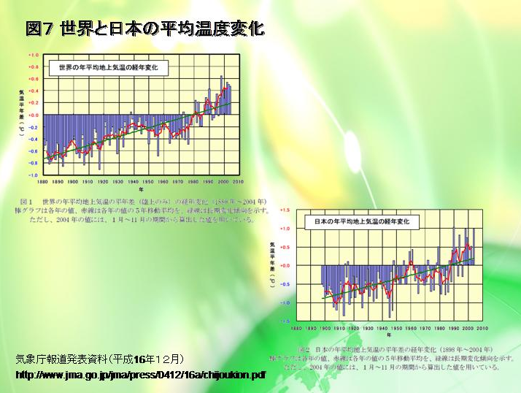
世界及日本的平均气温变化

Slide 30
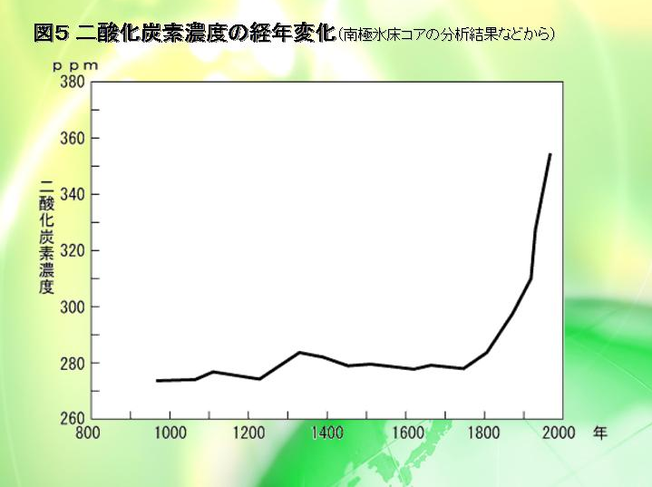
二氧化碳浓度的历史变化 （数据来源于南极冰川深层分析等）

Slide 31
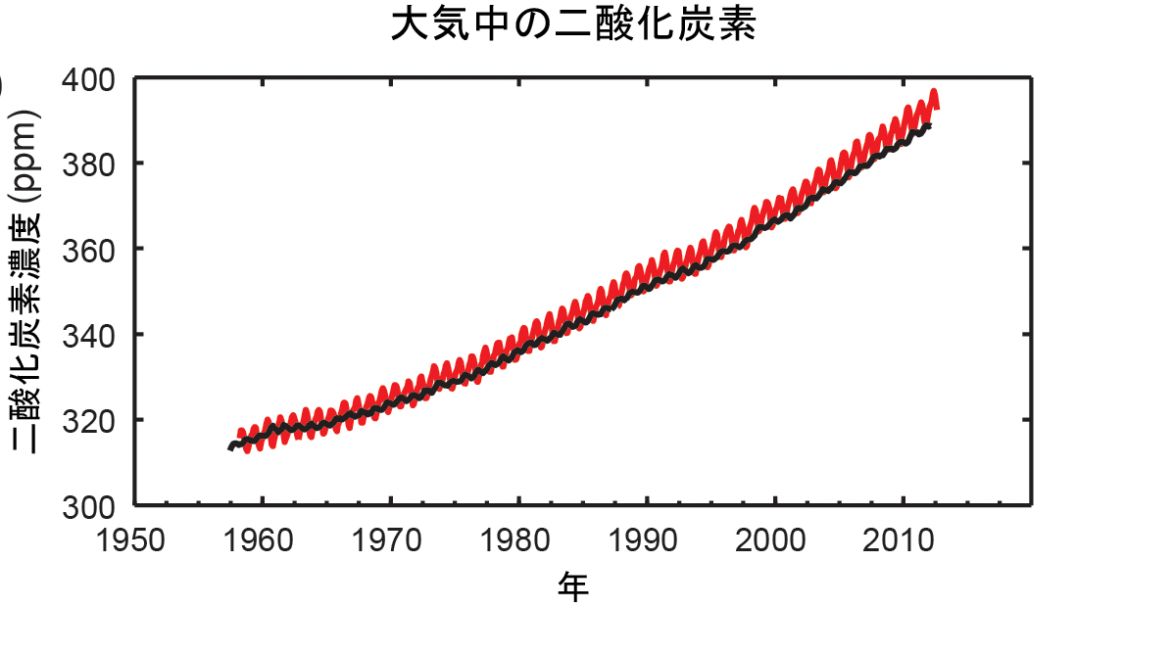
大气中的二氧化碳浓度
データは、 1958 年以降のマウナロア（北緯19 度32 分、西経155 度34 分：赤）と南極点（南緯89 度59 分、西経24 度48 分：黒）における大気中の二酸化炭素濃度。
出典IPCC第5次報告書
（第1作業部会報告書）

Slide 32
Professor Akimasa Sumi and his collaborators have carried out computer simulations using climate models for many years.
According to their results, it seems very very clear that the anthropological emission of greenhouse gases (mainly CO2) is a main contributor to the global warming.

Slide 33
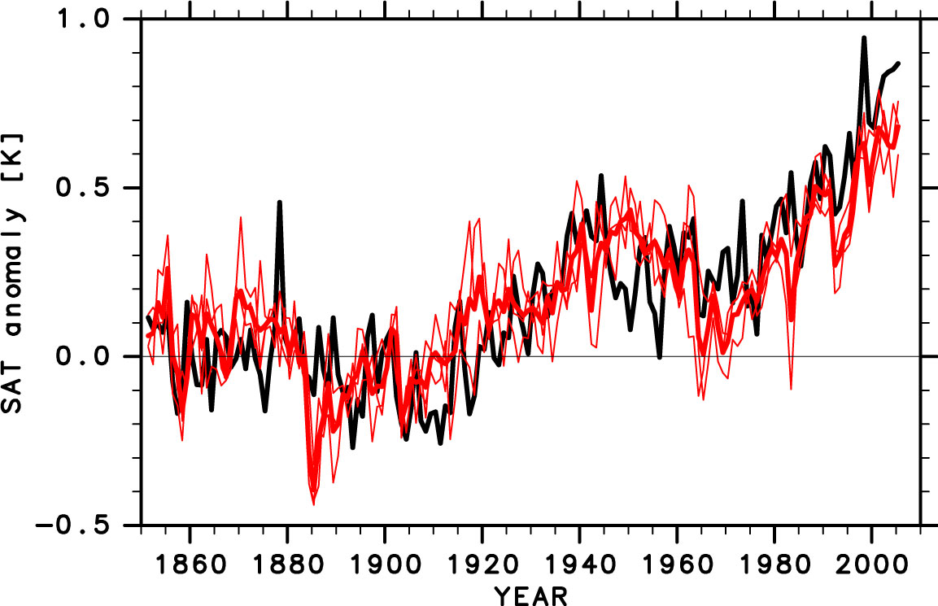
２０Century Climate Change Simulation by MIROC-Earth System Model
Anthro+Natural
ΔTs [℃]
Natural Forcing Only
（Solar Var.＋Volc. Acti.）
Years
Notes:
全球年平均地上気温の時間変化。黒太線は観測値を、赤太線は計算結果（初期値の異なる3実験の平均）を示す。観測、モデルとも、1851～1900年の平均気温を引いたもの。赤細線は初期値の異なる3実験それぞれの結果を示す。上段はすべて（自然＋人為）の気候変動要因を考慮した場合、下段は人為起源の気候変動要因のみを考慮した場合。最新の地球システム統合モデルを用いても、20世紀最後の30年程度の昇温傾向は、人間活動に伴う気候変動を考慮しなければ再現できない。

Slide 34
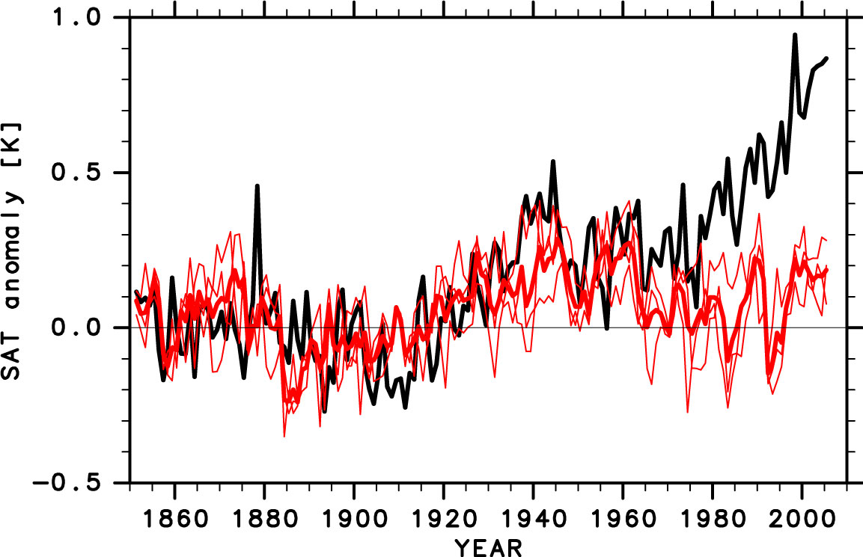
Only natural
ΔTs [℃]
Years

Slide 35
According to IPCC (2014), green house gas (namely CO₂) must be reduced by 40～70% until 2050.

Slide 36
４ 可再生能源
再生可能エネルギー

Slide 37
The development of renewable energy has to promoted.
However, it will require sufficient resources of time and budget.

Slide 40
The electric power generated by renewable energy is predicted as Fig. 14 shows.
The electric power generated by renewable energy other than water power increases very slowly from about 4% in 2010 to only 15% in 2035,
as shown in Fig. 14.

Slide 41
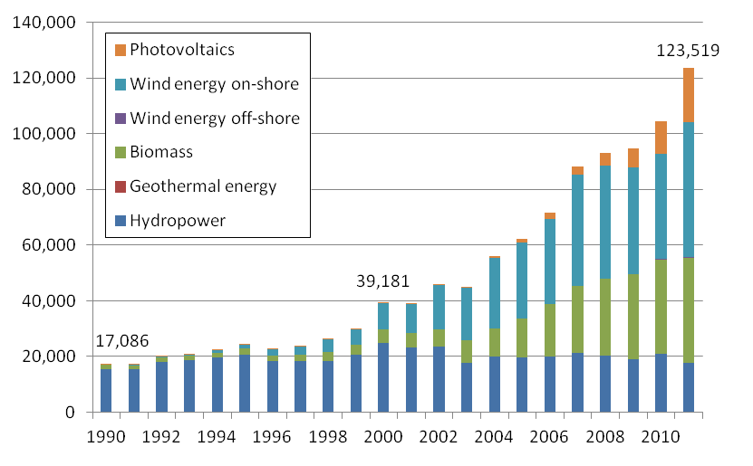
Development of renewables-based electricity generation in Germany
Increased trippled(from 2000 to 2011)
（GWh）
【Generated Energy of Renewables-based Electricity】
Source：BMU）「Entwichlung der erneuerbaren Energien in Deutschland im Jahr 2011」

Slide 42
Taking off that generated by water power,
we have 82.9 billion kWh. The total electric power generation in Japan was 976.2 billion kWh in 2010.
Namely the electric power generated by renewable energy other than water in Germany in 2010 was only 8,5% of the total electric power generation in Japan in the same year.

Slide 43
The electric power generated by nuclear energy in Japan was 300.4 billion kWh in 2010.
Therefore the electric power generated in Germany by renewable energy other than water in 2010 is only 28% of it.

Slide 44

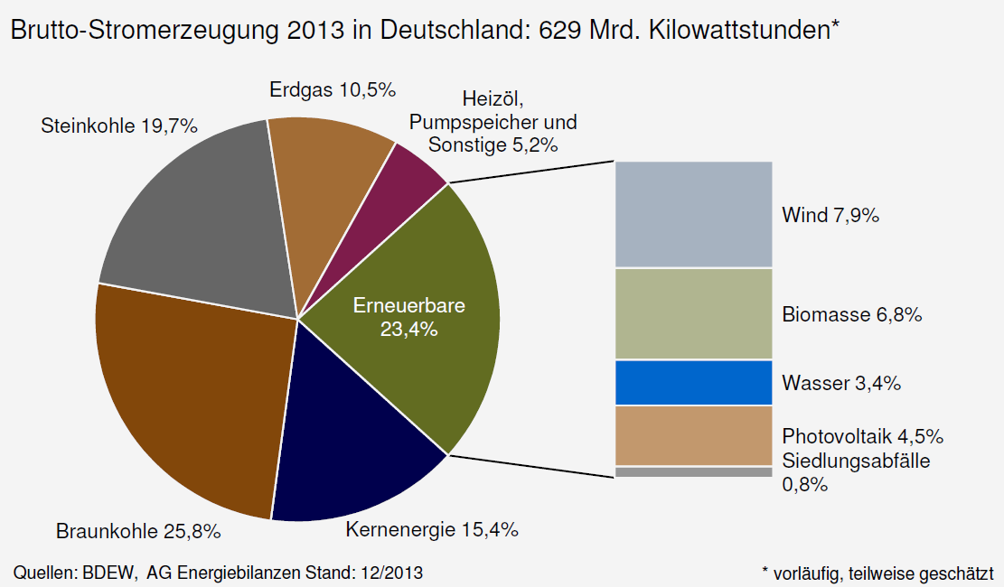
2013年発電実績
天然ガス
石炭
石油・揚水発電
再生可能
エネルギー
褐炭
原子力
44

Slide 45
Even if Japan strives as much as Germany,
it takes at least thirty years to replace the nuclear energy by renewable energy.
Meanwhile Japan must depend on fossil fuel, which increases the CO₂ emission into the air.
In order to import fossil fuel, the deficit in foreign trade of Japan, which is now already more than 4 trillion yen (about $40 billion), will continue to increase.

Slide 46
When we stop all nuclear power stations in Japan, the renewable energy must be increased not only to replace the nuclear energy but also the energy produced by fossil fuel. It is really possible in near future? It is time for us to deliberate the future of energy in Japan in order to guarantee the energy security, to avoid the global warming and to stabilize the economy of Japan.

Slide 47
５ 福岛第一核电站事故
福島第一原子力発電所の事故

Slide 48
Tohoku District - off the Pacific Ocean Earthquake
Occurrence: 14:46 March11, 2011
Mw(moment magnitude): 9.0
Epicenter: approximately 130km
off the coast of Sanriku
(at 38.10 degrees north latitude,
142.86 degrees east longitude
and 23.7km deep)
Map of JMA seismic intensities observed during the main shock.
48

Slide 49
在此由衷地感谢台湾各界对东日本地震海啸灾难后的重建工作所提供的大量捐款和援助。
東日本大震災・大津波の災害に対しまして、
台湾の方々が多額の見舞金と大きな支援の手を
さしのべて下さったことに心より感謝いたします。

Slide 50
(1)Occurrence of the Accident
Fukushima Dai-ichi Nuclear Power Station was attacked by the earthquake and tsunami
The scale of the earthquake was M9.0.
The protective infrastructure was designed only to withstand a tsunami of maximum height 5.7m
The height of the Tsunami was in excess of 15m
at the Fukushima Dai-ichi

Slide 51
Damage caused by the earthquake and tsunami(No.1)
Catastrophic earthquake and tsunami
March 11, 2011
16,000 people lost their lives and
3,000 people remain missing
No deaths as a result of radioactive fallout
from the Fukushima Dai-ichi Nuclear Power Plant

Slide 52
Damage caused by the earthquake and tsunami(No.2)
Total damage cost will be of the order of 169 billion yen ($2 billion), 18% of Japan’s budget.
130,000 homes were completely destroyed.
270,000 homes were partially destroyed.
The areas of arable land that incurred damage is 24,000 ha.
4 nuclear power plants and 12 thermal power plants were damaged.

Slide 53
Damage to the Nuclear Power Stations
There are 15 commercial nuclear reactors.
14 of these suffered major damage as a result of the Tsunami (not by the Earthquake).
The situation at 3 reactors of the Fukushima
Dai-ichi was very serious due to the resultant damage to their reactor core.

Slide 54
Status of the Fukushima Dai-ichi Nuclear Power Station before earthquake and tsunami
Status of 6 reactors before the earthquake and tsunami
Unit１：under operation
Unit２：under operation
Unit３：under operation
Unit４：under periodic inspection( all the fuel were removed from the reactor to the spent fuel pool)
Unit５：under periodic inspection
Unit６：under periodic inspection
。

Slide 55
Main Sequence of the Accident (No.1)
Main sequence of accident at reactors 1 to 3
Reactors 1 to 3 went into automatic shutdown following the earthquake and emergency diesel generators started up.
Earthquake and subsequent tsunami broke the reactors’ connection to the external AC power supply.

Slide 56
Main Sequence of the Accident (No.2)
Main sequence of accident at reactors 1 to 3
Tsunami caused the emergency diesel generators to cease working.
Then the reactors and the spent fuel pools became unable to be cooled.
This triggered a core nuclear meltdown in reactors 1 to 3, and hydrogen explosion in the buildings of reactors 1, 3 and 4.

Slide 57
Current Status of the Reactors
A two-step cooling operation (Step1 and Step2) in reactors 1 to 3 was executed.
In December 16, 2011, it was announced that this cold shutdown state had been achieved.

Slide 58
Recent issues in Japan
Waste Contaminated with Radioactive Materials
due to the Accident at Fukushima Nuclear Power Stations

Slide 59
Comparison of the Chernobyl and Fukushima nuclear accidents:
the environmental impacts
Chernobyl accident
Both Maps
on the same scale
Fukushima accident
http://www.meti.go.jp/earthquake/nuclear/pdf/130314_01a.pdf

Slide 60
Comparison of the Chernobyl and Fukushima nuclear accidents:
the radionuclides released
Ｉ ₁₃₁
_{Ｃｓ134}
Ｉ ₁₃₁
_{Ｃｓ137}
_{Ｃｓ134}
_{Ｃｓ137}
_{Ｓｒ90}
_{Ｓｒ90}
_{Ｐｕ239}
_{Ｐｕ239}
Chernobyl
Fukushima
Plutonium 239
Strontium 90
Chernobyl accident
http://www.meti.go.jp/earthquake/nuclear/pdf/130314_01a.pdf

Slide 61
Controlling the Release of Radioactive Materials
The amount of radioactive materials (cesium) released from Unit 1-3 PCV is assessed based on airborne radioactive material concentrations (dust concentration) at the top of Reactor Buildings
→Calculated the assessed value of total release amount (as of May 2013) as about
10 million Bq/hr.
→About one-80 millionth compared to immediately after the accident.
Accordingly, assessed the exposure dose at site boundary as 0.03mSv/yr. at maximum.
(Excluding effect of already released radioactive materials) Note: Exposure limit established by law is 1mSv/yr.
The release amount per hour of the radioactive material (cesium) from Unit 1～3
10
15
Approximately one-80 millionth
compared to
at the time of accident
10
13
Release Rate (Bq/hr)
10
11
about 10million Bq/hour
(about 1×10⁷ Bq/hour)
10
9
3/15
3/25
4/4
6/20
7/26
9/1
10/3
11/1
11/26
12/28
2/1
2/24
3/27
May
July
Sept.
Nov.
Jan.
Mar.
May
July
2011
-
3/26
-
4/6
-
6/28
-
8/12
-
9/17
-
10/13
-
11/10
-
12/6
-
1/13
-
2/13
-
3/7
-
4/15
2013
2012
Radioactive particle (Cesium) release per hour from Units 1 to 3
Notes:
61

Slide 62
Current radioactivity density measurement results inside and outside the port
2. Outflow of Contaminated Water into the Port
At the locations in front of Units 1-4’s water intakes ( ),
the All-β and Tritium densities in seawater have been showing repeated fluctuations.
At the locations inside the port ( ), the densities in seawater have been almost below the detection limit values.
At the locations near the boundary of the port ( ), the densities have been at the same levels or lower than those inside the port.
At the locations 3km and 15km offshore the power station, and 3km offshore the Ukedo River, the All-β and Tritium densities have been below the detection limit values.
3km off Fukushima Daiichi
Note: Cesium 134 designated concentration: 60
Cesium137 designated concentration: 90
Strontium 90 designated concentration: 30
Tritium designated concentration: 60,000
<Water quality measurement results (excerpts);
sampling dates are in parentheses> (Units: Bq/L)
Cesium-134 ：ＮＤ
Cesium-13７ ：１．４
All-β ：ＮＤ
Tritium ：６．７
Analysis items and measurement frequencies
・Tritium, Cesium and All-β: Once a week
・Strontium: Once a month
Port entrance
Cesium-134 ：ＮＤ
Cesium-13７ ：ＮＤ
All-β ：ＮＤ
Tritium ：0.41
Cesium-134 ： ６．２
Cesium-13７ ： １９
All-β ： １１０
Tritium ： １３０
Monitoring of effect on the ocean
Monitoring of distribution of radioactivity densities inside the port
Monitoring of effect inside the port
Newly added points outside the port
Cesium-134 ：ＮＤ
Cesium-13７ ：１．６
All-β ：ＮＤ
Tritium ：７．２
Cesium-134 ：１．７
Cesium-13７ ：２．５
All-β ：ＮＤ
Tritium ：５．４
Cesium-134 ： １６
Cesium-13７ ： ４１
All-β ： ２８０
Tritium ：３，０００
Cesium-134 ：ＮＤ
Cesium-137 ：ＮＤ
All-β ：ＮＤ
Tritium ：２．７
Cesium-134 ：ＮＤ
Cesium-13７ ：ＮＤ
All-β ： ２１
Tritium ： １８
Cesium-134 ：ＮＤ
Cesium-13７ ：ＮＤ
All-β ：ＮＤ
Tritium ：ＮＤ
Sea-side impervious wall (under construction)
Near the south water outlet
North of Units’ 5-6 water outlet
Cesium-134 ：１．７
Cesium-13７ ：２．７
All-β ： ２１
Tritium ：ＮＤ
No.1
No.2
No.3
U１
U2
U３
U４

Slide 63
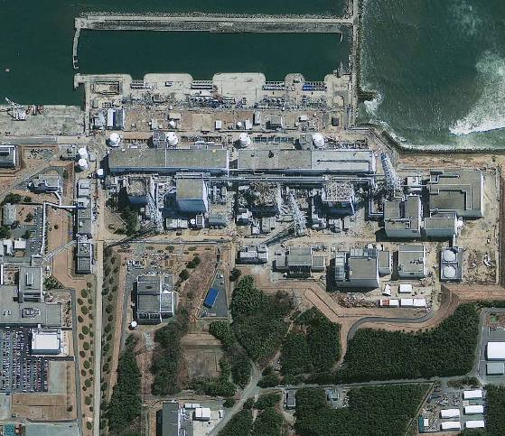
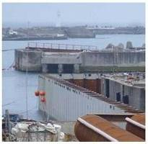
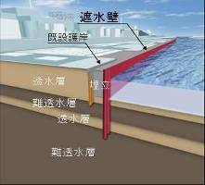
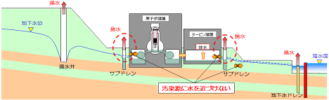
3-（2）Overview of measures for contaminated water/ fundamental measures
63
3 measures will be implemented in the next 1 to 2 years with the purpose to “inhibit outflow to sea”, “control increase of contaminated water and prevent outflow to the bay” and “prevent inflow of groundwater to reactor building”, aiming to fundamentally resolve the problem of contaminated water.
Inhibition of outflow to sea : Installation of sea-side impermeable wall 【No leaking】
Control of increase of contaminated water / prevention of outflow to the bay : Installation of land-side impermeable wall (frozen soil method) 【Keeping away】 【No leaking】
Control of inflow of groundwater to reactor building : Groundwater pump-up from subdrain 【Keeping away】
Measure①
Measure②
Measure③
Conceptual diagram of fundamental measures
Measure①
Inhibition of outflow to sea : Installation of sea-side impermeable wall
・ Construction began on the sea side of the seawall, aiming for completion in September 2014.
※It will be necessary to pump of water that accumulated due to the impermeable wall, but this will be handled by installing pumping well.
①sea-side impermeable wall
②Land-side impermeable wall (frozen soil method)
Impermeable wall
Impermeable wall
Existing seawall
Unit 1
Unit 2
Unit 3
Unit 4
③Pump-up with subdrain
Source: Japan Space Imaging Corporation, (C)DigitalGlobe
Measure②
Control of increase of contaminated water / prevention of outflow to the bay :
Installation of land-side impermeable wall (frozen soil method)
Measure③
Control of inflow of groundwater to reactor building : Groundwater pump-up
from subdrain
<Procedures for construction of frozen soil wall>
・Increase of contaminated water, caused by groundwater flowing into the building, can be controlled by installing an impermeable wall around the building.
・ Inflow of groundwater to the building will be controlled by restoring the subdrain and pumping up groundwater around the building.
Boring
Installation of frozen ducts
Coolant circulation (formation of frozen soil)
Circulation of coolant
・Water level will be managed in order to prevent outflow of water accumulated inside the building.
Frozen duct
Frozen soil
Frozen soil
Keep water away from source of contamination

Slide 64
2-（1）Overall image of roadmap for reactor decommissioning
64
Goal of roadmap (drawn up in December 2011)
Dec. 2011
Dec. 2013
Dec. 2021
30-40 years later
Initiatives for
stabilization
Term 1
Term 2
Term 3
Period until start of removal of fuel inside the spent fuel pool (within 2 years)
Term until start of removal of fuel debris (within 10 years)
Period until decommissioning is completed
(30-40 years later)
<Achievement of cold shutdown>
・Cold shutdown state
・Drastic control of release
※Fuel debris
(Molten fuel and cover pipes that have solidified)
Steps until removal of fuel debris (Unit 1, Unit 2 and Unit 3)
Removing fuel debris while submerged is the most assuring way to remove fuel from the perspective of work exposure mitigation.
In view of the work steps, technologies necessary for removal, containment and storage of fuel debris will be developed, in addition to surveys and repair for filling the reactor containment vessel with water (surveying damaged areas with robot cameras and sealing holes) and surveys of fuel debris.
Ceiling crane
Container
Spent Fuel Pool
Upper lid of pressure vessel
Fuel debris container
Penetration
Carried out
Penetration
Filling with water
Waterproofing
Repair of bottom of reactor containment vessel (waterproofing)～Filling lower part with water (image)
Fuel debris removal (image)

Slide 65
2-（2）Major processes toward reactor decommissioning
65
Dec. 2013
Dec. 2021
30-40 years later
Major items |  |  | Progress
【Common】 Development of major processes | Units 1-3 |  | Being examined
【Removal of spent fuel】 Preparatory process ・Rubble removal ・Decontamination, sealing ・Installation of removal equipment Fuel removal process ・Licensing ・Training ・Safety measures | Unit 1 |  | Working toward cover disassembling
 | Unit 2 |  | Operating floor being surveyed
 | Unit 3 |  | Conducting rubble removal / decontamination
 | Unit 4 |  | Fuel being removed
【Fuel debris】 Preparatory process for removal ・Decontamination inside buildings ・Containment vessel, building repair (waterproofing) ・Research and development | Unit 1 |  | Major processes being developed and removal plan being drawn up
 | Unit 2 |  | Major processes being developed and removal plan being drawn up
 | Unit 3 |  | Major processes being developed and removal plan being drawn up
Term 1
Term 2
Term 3
Period until start of removal of fuel inside the spent fuel pool
Term until start of removal of fuel debris
(within 10 years)
Period until decommissioning is completed
(30-40 years later)
As of
March
2014
▼
～2015
▼
Plan of major processes of each unit determined
Building cover disassembling ~ Rubble removal / decontamination / sealing
~ Fuel removal equipment installation
FY2017 H2 (fastest plan)
Latest plan
▼
▼
Fuel removal
Operating floor decontamination (dose reduction)
~ (Disassembling of upper part of building) ~ Fuel removal equipment installation
FY2017 H2 (fastest)
Latest plan
▼
▼
Fuel removal
Operating floor rubble removal, decontamination / sealing (dose reduction)
~ Fuel removal equipment installation
FY2015 H2 (fastest plan)
Latest plan
▼
▼
Fuel removal
Rubble removal / decontamination / sealing～Fuel removal equipment installation
November 2013
December 2014
▼
▼
Fuel removal
Fuel debris removal preparations
FY2020 H1 (fastest plan)
▼
Fuel debris removal
Fuel debris removal preparations
FY2020 H1 (fastest plan)
▼
Fuel debris removal
Fuel debris removal preparations
FY2021 H2 (fastest plan)
▼
Fuel debris removal

Slide 66
International Research Institute for Nuclear Decommissioning

Slide 67
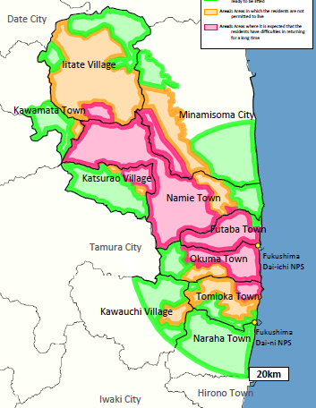
Protected Areas
Legend
:Areas to which evacuation orders are ready
to be lifted
( ≦20mSv/year)
:Areas in which the residents
are not permitted to live
(20mSv/year < ≦50mSv/year)
:Areas where it is expected that the residents
have difficulties in returning for a long time
(50mSv/year < )

Slide 68
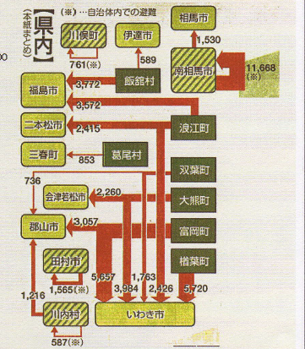

Slide 69
６ 东北电力女川核电站与
东京电力福岛第二核电站
東北電力女川原子力発電所と
東京電力福島第二原子力発電所

Slide 70
If we prepare Nuclear Power Stations for earthquake, tsunami, we can avoid serious damages.
Examples
Onagawa NPS of Tohoku EP Co.
and
Fukushima Dai-Ni (第2) NPS of Tokyo EP Co.

Slide 71
6-1 东北电力女川核电站
東北電力女川原子力発電所

Slide 72
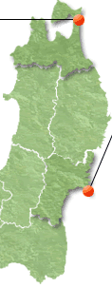
Onagawa / Fukushima Daiichi on March 11, 2011
Higashidori NPS
Tohoku EPCo.
 | Acceleration (gal) | Tsunami Height (m)
Onagawa | 567 （Unit 1） | 13 （measured）
Fukushima Daiichi | 550* （Unit 2） | 13* （estimated）
★
Sendai
Epicenter
* ：Report on Fukushima Nuclear Accident ,
Tokyo EPCo., June 20, 2012
Fukushima Daiichi NPS
（Tokyo EPCo.）

Slide 73
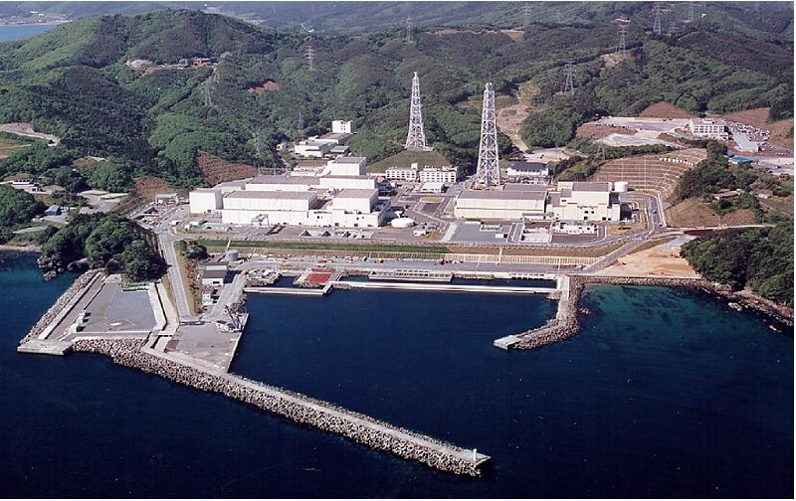
Tsunami Overview
Internal Flooding of Unit 2 Rx. Aux. Build.
Fuel Oil Tank
Site Grade : 14.8m - α
Harbor Level : 3.5m - α
Highest Tsunami : 13m
( at 15:29 )
α : Subsidence

Slide 74
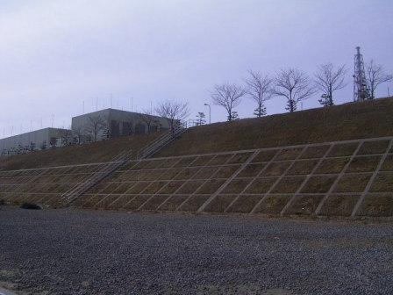
Onagawa Site Grade Reinforcement
Tsunami Prediction Updated
(Unit 2 License Application)
O.P.+14.8m
O.P.+9.7m
Concrete Reinforcement up to 9.7m
Concrete Reinforcement
O.P.+14.8m
Concrete
Reinforcement
O.P.+9.7m
Foundation
1:1.5
0.3m
O.P.+3.5m
1.0m
2.1m
Notes:
Reference 4: Embankment Protection
Estimated tsunami height: 9.1m when the construction permit on unit 2 was applied in 1987
Concrete protection constructed up to 9.7m
Design consideration
Stability against ebb tide
Seismic performance
Withstood against the repeated tsunami
Concrete protection
Foundation
*: Design height

Slide 75
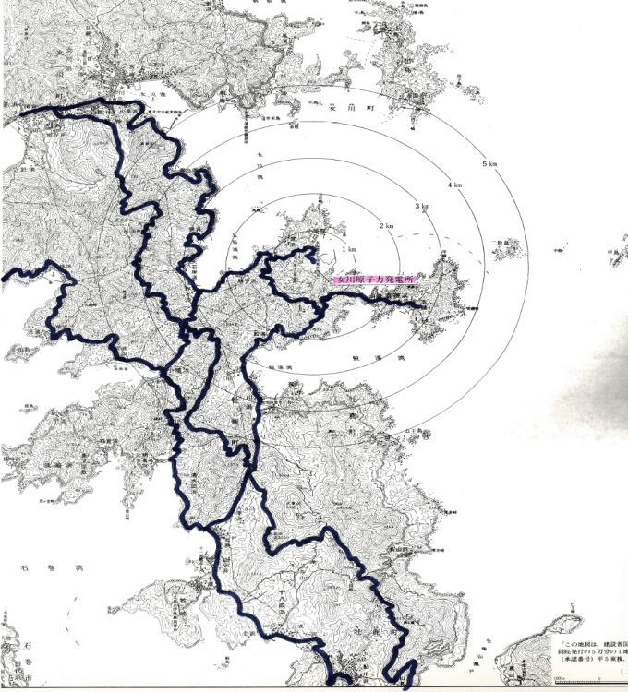
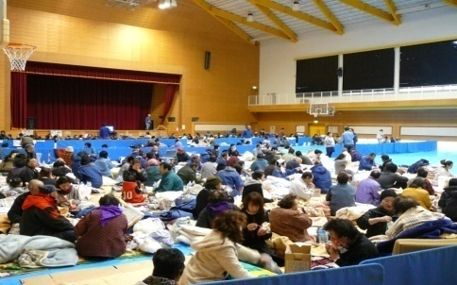
Helping Our Neighbors
March 11 ～ June 6, 2011 Max : 364 local residents
Gymnasium inside Onagawa NPS
Onagawa NPS
: Locations of road collapse
after earthquake
Notes:
Reference 2: Evacuees in Onagawa Nuclear Power Station
Number of evacuees in Onagawa Nuclear Power Station
Downtown Onagawa
Evacuees stayed from March 11 to June 6, 2011
Maximum number: 364 on March 14
Evacuation places
Visitor center
Former office building
Gymnasium
Number of evacuee/regional population
Location of road collapse after earthquake
Miscellaneous region (12)
75

Slide 76
6-2 京电力福岛第二核电站
福島第二原子力発電所
Magnitude of the earthquake; 9,0
The height of the tsunami; 15m

Slide 77
福岛第二核电站启动冷温停止程序的过程(以一号机为例)
対応の
流れ
止める
冷やす
閉じこめる
原子炉減圧（高圧注水設備停止前に実施）
原子炉循環冷却
（～約3日後）
(福島第二の復旧実績)
・原子炉水を循環
させ、熱交換器を
通して熱を除去
対
応
方
法
原子炉
緊急停止
（～数秒）
・制御棒
緊急挿入
・停止直後の減圧（～約1時間後）
（高圧注水設備を使用できない場合）
・高圧注水継続後の減圧
（～高圧注水設備停止前(半日程度)）
（低圧注水設備に切り替える場合）
原子炉注水冷却
・原子炉圧力に応じた設備(高圧注水設備, 低圧注水設備)を選択して実施
3/11
14：46
地震発生
3/12
4：58
原子炉隔離時冷却系
（高圧注水）停止
3/14
1：24
原子炉除熱開始
福島第二1号機の対応の概要
15：22
津波第一波
襲来
15：34
非常用ディーゼル
発電機停止
地震を
検知し、
数秒で
緊急停止
津波の影響による各種
常用/非常用機器の機能喪失後も
原子炉隔離時冷却系を起動して
高圧注水を継続
低圧注水に切替可能な
状態まで減圧
（復水補給水系での注入が可能な状態）
残留熱除去系
（RHR）を復旧し、
原子炉を循環冷却
→冷温停止へ
減圧後低圧注水
（復水補給水系）
高圧注水
減圧
低圧
注水
格納容器圧力上昇に備え、
ベント準備(結果的にRHRが復旧しベントは実施せず。)
逃がし
安全弁
復水
補給水系
原子炉
隔離時
冷却系

Slide 78
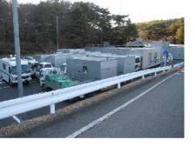
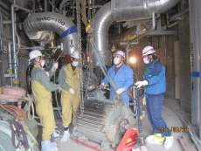
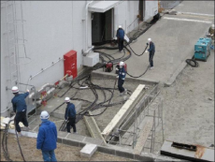
福岛第二核电站 机组人员的应急过程
○ウォークダウンによる設備被害状況の確認(平成23年3月11日深夜)
  津波警報が継続する中，所員の安全対策を講じた上でウォークダウン実施
  多くの機器損傷の状況で，短時間で効率的に除熱機能の回復方法を検討し， 機器復旧の優先順位を決定（ＲＨＲ（B）系の復旧を優先）
○復旧機材の緊急調達(平成23年3月12日)
  交換用電動機，電力ケーブル，電源車，移動用変圧器を緊急調達
  交換用電動機は，東芝工場から空輸，及び柏崎刈羽原子力発電所からのトラック搬送にて確保
○現場における機器及び電源の復旧(平成23年3月13日)
  ＲＨＲ（B）系の補機冷却系ポンプ点検，使用不能電動機の交換
  健全な廃棄物処理建屋電源盤を使用し，また高圧電源車と移動変圧器を現場に配備し，仮設ケーブルを布設
  総延長9kmの仮設ケーブルの大半を約200名の所員および協力企業社員の手でほぼ１日で布設
○残留熱除去系のポンプを起動し原子炉の冷却を開始
(平成23年3月14日)
電源車の調達
フルＡ
－
フルＢ
９
フルＣ
－
ミドル
－
電動機の交換
ミドルＡ
－
ミドルＢ
９
ショートＡ
８
ショートＢ
８
仮設ケーブルの布設
ショートＣ
９
Ａ３ 1枚版
－
さまざまな努力により，平成23年3月15日 午前7時15分に
全号機において冷温停止を達成
プレゼン用（プロジェクタ用or（紙の場合）説明者用１部）は黒塗りを削除すること
（配布用は黒塗りあり）
目的外使用・複製・開示禁止 東京電力株式会社

Slide 79
防災技術を大いに進め、原子力に限らず、
高層建築、高速鉄道、高速道路、航空機などの
防災に努力しようではありませんか。
中国语翻译：大力发展包括核能、高层建筑、高速铁路、
航空等领域的防灾科学技术，是大势所趋。
東日本大震災が発生したとき、地震地帯を
新幹線の高速列車が80台走っていましたが、
地震を感知するや否や安全に停車しました。
防災をきちんとしていれば、高速鉄道も安全
なのです。
中国语翻译：当东日本大地震来袭时，行驶于灾区的共计80辆新干线 全部实现了安全停车。有些车辆在没有借助地震感应器的情况下，通过间接的应急机制实现了安全停车。完善的防灾技术，也能为新干线系统提供安全保障。

Slide 80
７ 人类原子能的将来
世界の原子力の将来

Slide 81
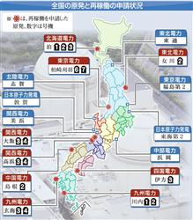
核电站的分布及有关机组再启运的申请情况

Slide 82
Additional Safety Measures
【Previous Regulatory Requirements】
【New Regulatory Requirements】
【Additional Measures to be Implemented 1-15】
Seismic/tsunami resistance
Seismic/tsunami resistance
(1) Earthquake countermeasure
Consideration of natural phenomena
Tsunami resistance measures
Fire protection
Consideration of natural phenomena (Specification of, volcanic eruptions, tornados, and forest fires)
(2) Tornado resistance measures
Reliability of power supply
Design basis
Function of other Structure, System, and Components (SSCs)
Fire protection
(3) Fire resistance measures
Consideration of internal flooding
(4) Flooding resistance measures
Function of other SSCs*¹
(5) Enhancement of reliability of static equipment
(15) Other measures
Accident management measures
(Autonomous Chubu Electric Power measures)
Measures to prevent core damage (postulate multiple failures)
(7) Reinforced water injection functions
(8) Reinforced depressurization functions
(9) Reinforced guarantee of power supply
(10) Measures to respond to hydrogen inside filter vent equipment
(1)Earthquake countermeasure
(6)Tsunami resistance measures
(12) Reinforced of instrument functions
(13) Reinforced of functions of emergency response center
(14) Ensuring storage area& access routs
Measures to prevent containment vessel failure
Severe accident standards
* In the wake of the accident at Fukushima Daiichi Nuclear Power Station, existing design basis have been newly introduced and reinforced, and new standards (severe accident standards) have been added to respond to severe accidents exceeding the design basis.
Based on these essential requirements, Chubu Electric Power will implement the additional measures shown in the chart at the right.
Measures to suppress radioactive
materials dispersion
(11) Measures to control spread of radioactive substance outside facility
Response to intentional aircraft crashes (specialized safety facility,* etc.)
Response is deferred for a five-year period following the formulation of the new regulatory requirements; we will proceed with studies in the future.

Slide 83
エネルギー基本計画
2014年4月閣議決定
(1)再生可能エネルギー ＊）
これまでのエネルギー基本計画を踏まえて示した水準を更に上回る水準の導入を目指す
＊）2009年8月
2020年の発電電力量のうち再生可能エネルギー等の割合は13,5%
2010年6月
2030年の発電電力量のうち再生可能エネルギー等の割合は約2割
中国语翻译：（1）可再生能源
基于以往的能源计划，设定更具挑战性的能源目标
2009年8月
到2020年，可再生能源发电量的比重提高至总发电量的13.5%
2010年6月
到2030年，可再生等能源发电量的比重提高至总发电量的20%左右

Slide 84
(2) 原子力
エネルギー需給構造の安定性に寄与する
重要なベースロード電源
原子力規制委員会により世界で最も
厳しい水準の規制基準に適合と認め
られた場合には、（中略）
原子力発電所の再起動を進める
中国语翻译：原子能
核能是保障能源安全的基础能源
只有达到原子能管理委员会制定的世界上最严格的安全标准，核电站才能重新启运。

Slide 85
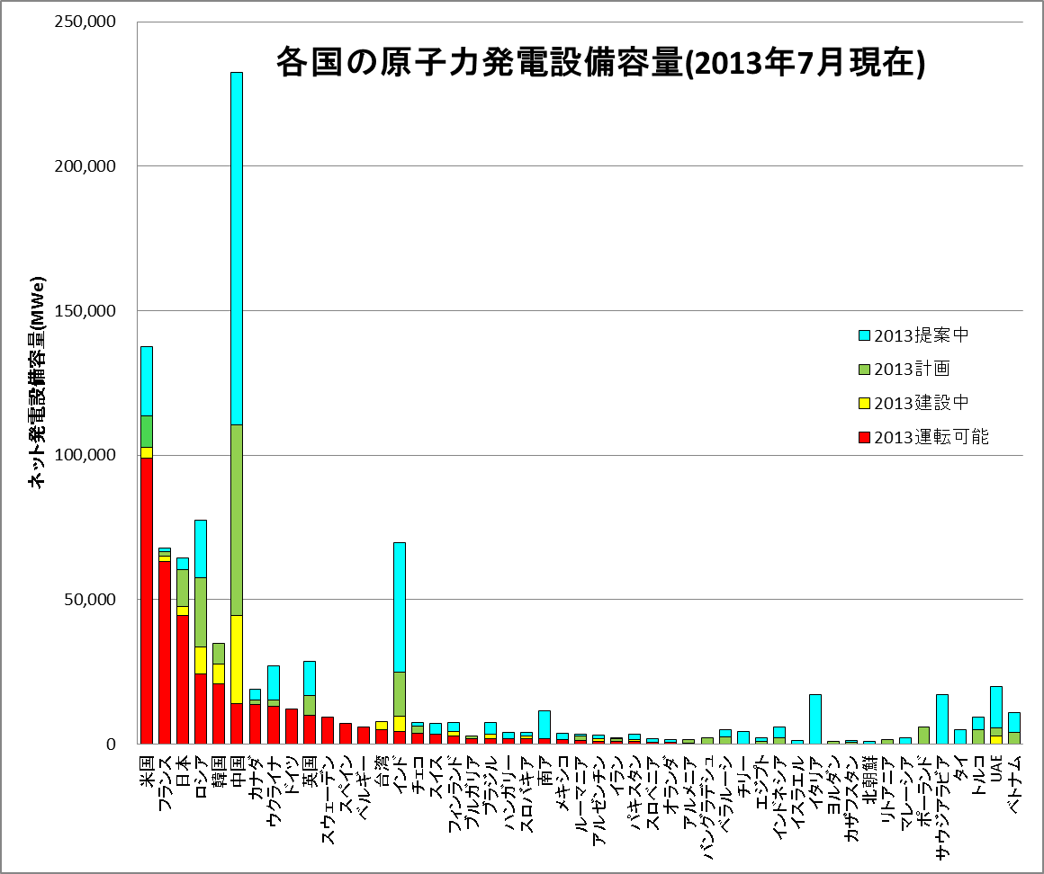
4-1 世界各国的核电装机容量
世界原子力協会資料より作成

Slide 86
原子力のバック・エンド技術
使用済核燃料の最終処理所
使用済核燃料の中にある強い放射能を持つ
原子核寿命を短くする技術（例ADS）を
研究開発せよ
中国语翻译：
积极开发原子能废料管理及设施退役相关的技术
核废料的最终处理设施
开发缩短核废料辐射周期的技术

Slide 87
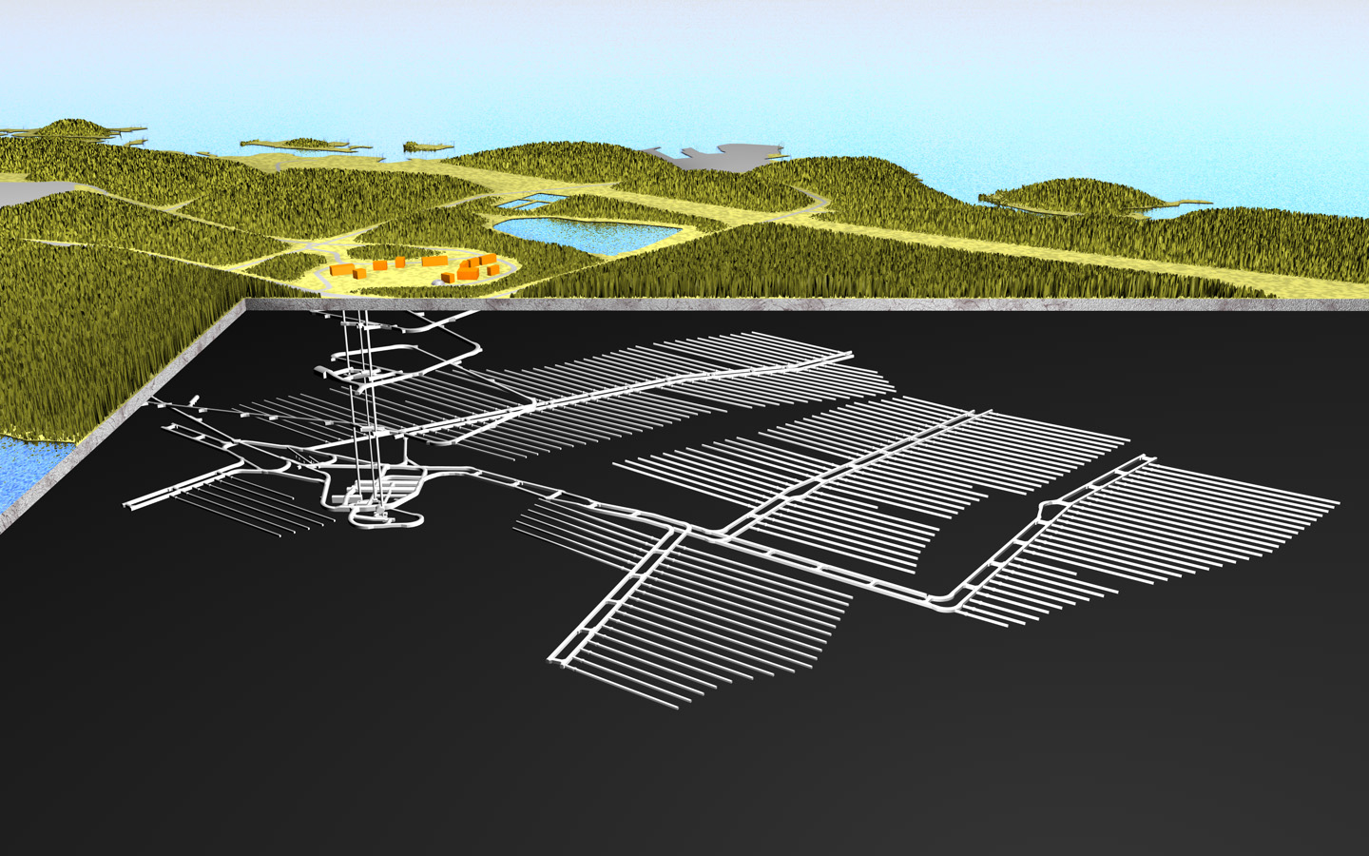
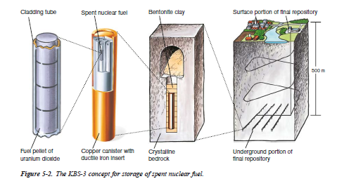
芬兰・Olkiluodon核废料处理厂概念图
（资料来源：POSIVA公司）
计划2028年营运
瑞典核废料地下处理厂的概念图
（新西兰采用同类标准、信息来源于安全评价书）
Notes:
両国ともに日仏とは違って、使用済み燃料の直接処分を計画していて、2030年ごろには操業開始の予定。スカンジナビア半島の強固な岩盤を想定しているが、実際には

Slide 88
Effect of P&T
  Reduction of long-term potential radiotoxicity
  Possible reduction of repository area
Normalized by 32,000 tHM of 45 GWd/t spent fuel
10¹⁰
Reduced from about 10,000
years to several hundred years!
Conventional concept
Long-lived low-heat generating
radioactive waste
10⁹
10⁸
HLW
(U,Pu: 99.9% recovery)
Vitrified waste
(Cooling time: 50 yr)
10⁷
Natural U (9t)
The repository area can be reduced to 1/4 by transmuting MA and separating Sr-Cs after 100-130 years.
Potential radiotoxicity (arb. units)
MA transmutation
+ FP partitioning
10⁶
10⁵
Sr-Cs calcined waste
10⁴
99.5% transmutation
of MA
Highly-loaded verified waste
+ Long-term storage of Sr-Cs
10³
The repository area can be reduced to 1/100 by applying ~300-year storage to Sr-Cs.
10⁰
10¹
10²
10³
10⁴
10⁵
10⁶
10⁷
Time after reprocessing (year)

Slide 89
Transmutation using Accelerator-Driven System(ADS)
Superconducting
linear accelerator
Proton beam
Principle of transmutation by ADS
Max.30 MW
Electric power
selling
Feed to accelerator
Make use of fission chain reaction in subcritical state
Proton
100 MW
Spallation target
170 MW
Fission energy
Fission neutron
Fast neutron
Electric generation
270 MW
800 MW
MA fuel subcritical core
Spallation target
Short-lived nuclide
Long-lived nuclide
Mechanism of ADS:
・Protons are accelerated by a superconducting accelerator with high intensity.
・Protons are directed to a lead-bismuth (Pb-Bi) target through a beam duct and a beam window.
・The Pb-Bi combines a reactor coolant with a spallation target.
・Major composition of the reactor fuel is MA.
・Spallation reactions generate a large number of neutrons.
・MAs are transmuted by neutron-induced fission reaction.
・Neutrons generated by the fission are also used for the transmutation.
→ neutrons are increased by 20 times by a fission chain reaction.
・The electricity generated by ADS is partly fed to its own accelerator.
Feature of ADS:
・If the accelerator runs down, fission chain reactions come to a stop. → High safety
・ Existing reactors (critical reactors) with a large amount of MAs cause safety difficulties, but that is not the case in ADS.
・Pb-Bi is chemically-inactive.

Slide 90
原子能相关学科的招生情况
○ ２０１３年度の志願者数は、昨年度に比べて、学部、修士、博士全てにおいて減、トータルでは約０．７割減。
○ ２０１３年度の入学者数は、昨年度に比べて、学部、博士で減、トータルでも減。
○ ２０１１年度以降、志願者数及び入学者数ともに減少傾向にはあるが、徐々に緩やかになってきている。
○ ２０１３年度に定員割れとなった学科・専攻は昨年度より１学科・専攻増加。
３

Slide 91
Concluding Remarks
1 Human beings cannot help depending on nuclear energy as well as other energy resources, including renewable energy, which do not emit CO₂ into the air.
2 Science and technology must be developed.
Science education is indispensable.
3 International cooperation must be strengtend.

Slide 92
I trust the wisdom of human beings.
Let us cooperate internationally in order to overcome difficult and serious matters which our human beings are encountering.

Slide 93
謝 謝

